Slide 1
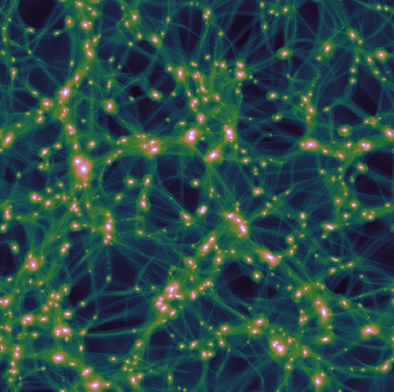
The gamma-ray signature of an early matter-dominated era
Sten Delos
Adrienne Erickcek
Tim Linden
(UNC-Chapel Hill)
(UNC-Chapel Hill)
(Ohio State University)

Slide 2
An early matter-dominated era (EMDE)
Possible domination by a pressureless fluid during the first second after inflation
EMDE?
Radiation domination
Matter domination
Dark energy
Inflation
BBN
Driven by unstable heavy relic such as
Dark mediator
String moduli fields
Inflaton
History prior to BBN is largely unconstrained.

Slide 3
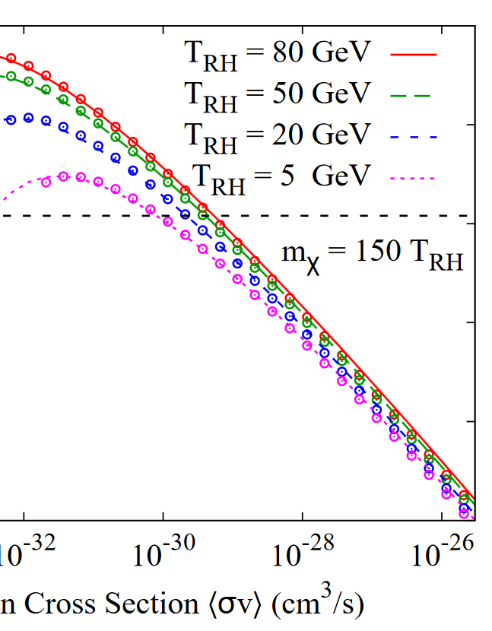
EMDE and thermal dark matter
Decaying relic sources radiation, diluting DM.
Need smaller cross section for correct relic abundance
Degeneracy between DM properties and EMDE widens field of viable dark matter models (e.g. binos)
Erickcek 2015
Can we detect smaller cross sections?

Slide 4
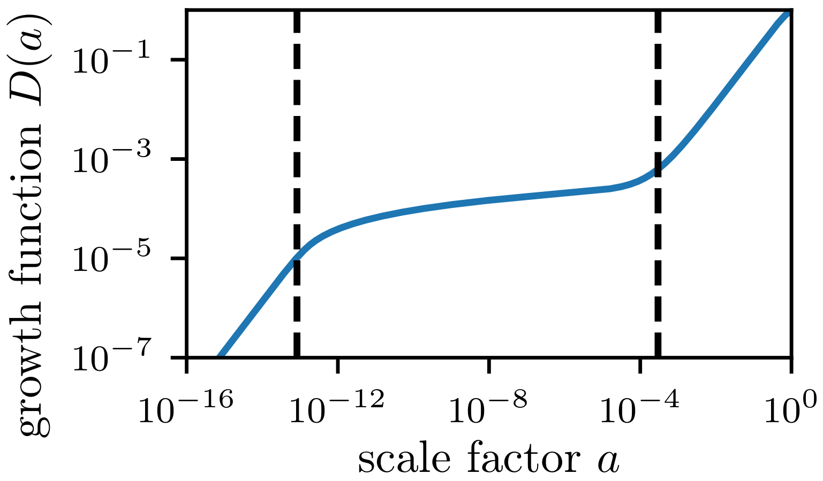
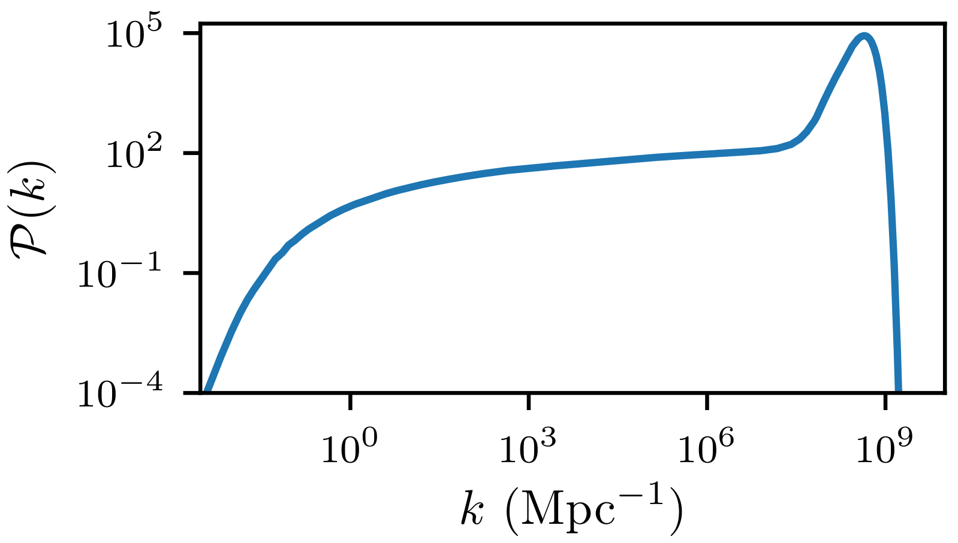
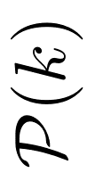
EMDE and density fluctuations
Subhorizon matter density fluctuations grow rapidly when pressureless fluids dominate.
Reheating
EMDE
Matter
dom.
Radiation domination
M-R equality
Matter power spectrum
Subhorizon during EMDE
An EMDE enhances small-scale fluctuations.
Cutoff from DM microphysics

Slide 5
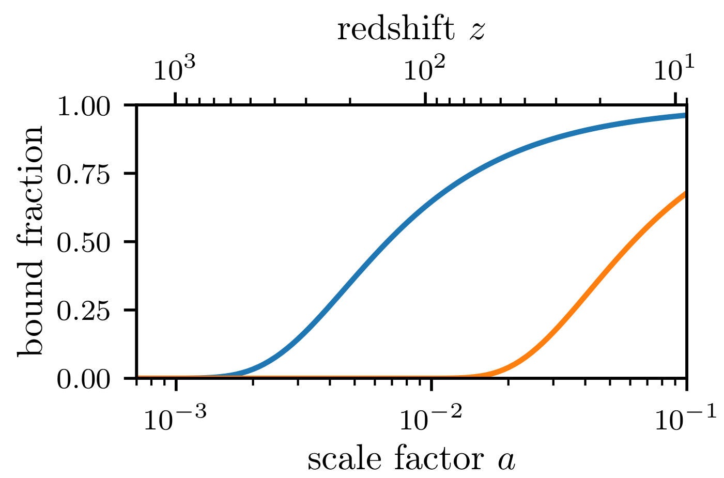
Microhalos
Due to EMDE, most dark matter is in superdense sub-earth-mass microhalos.
Microhalos
Galactic halos
Dramatically enhanced annihilation signal!
Do microhalos survive inside galactic halos?
1.5 parsec (comoving)
Possible “hole” in annihilation signal near centers of systems?

Slide 6
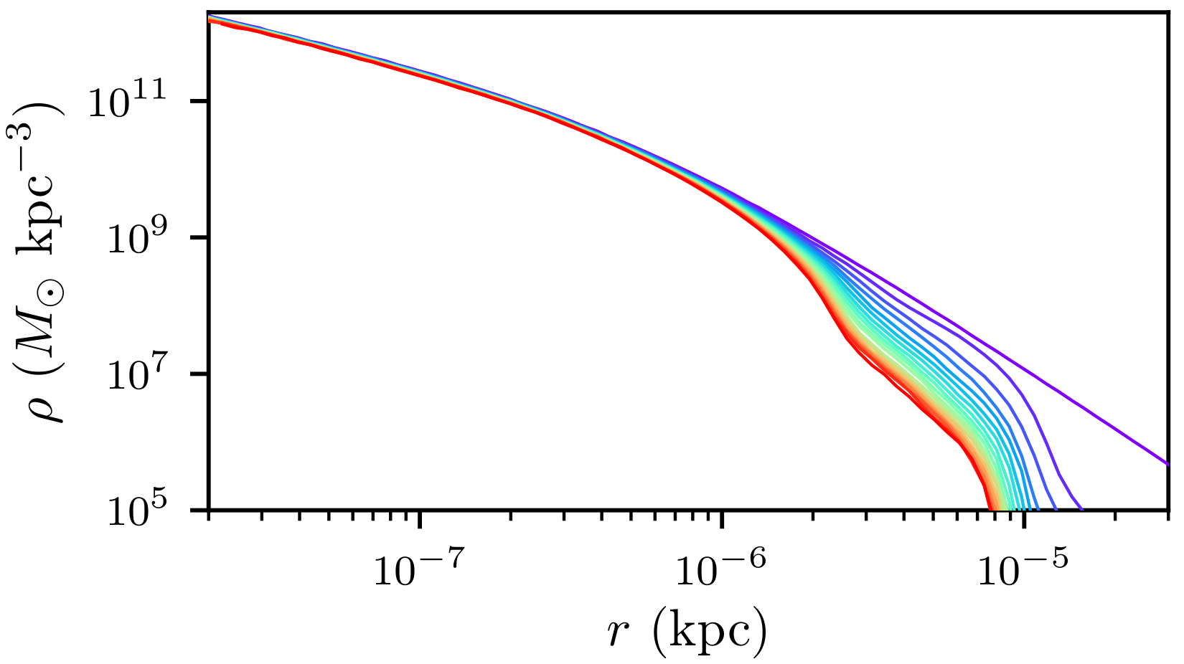
Simulating tidal stripping
N-body microhalo in orbit about analytic potential (dSph halo)
Host
Outer reaches are stripped, but the central density profile is largely unscathed.
bound/unbound to microhalo
0.03 parsec

Slide 7
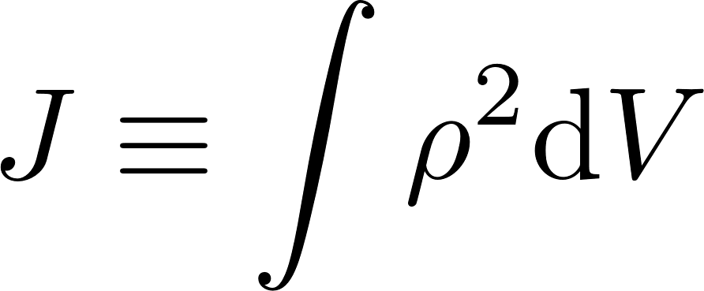
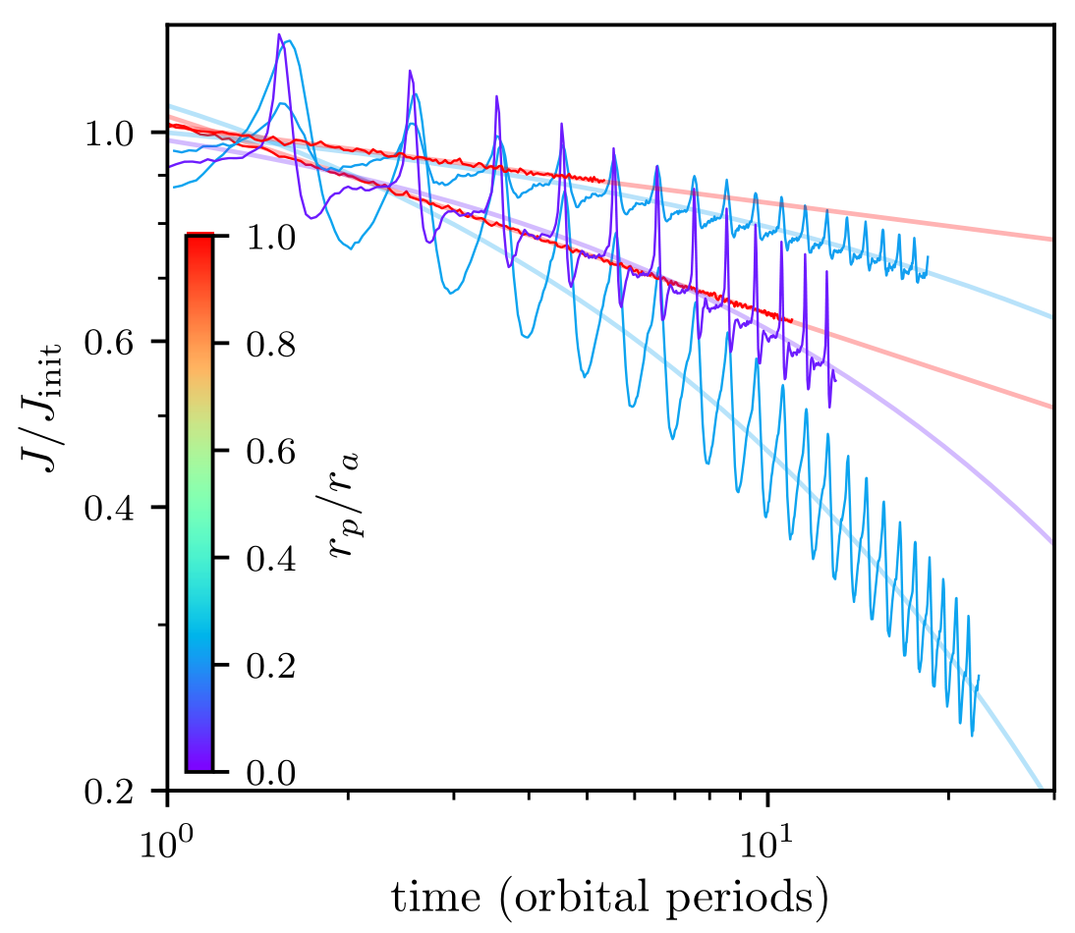
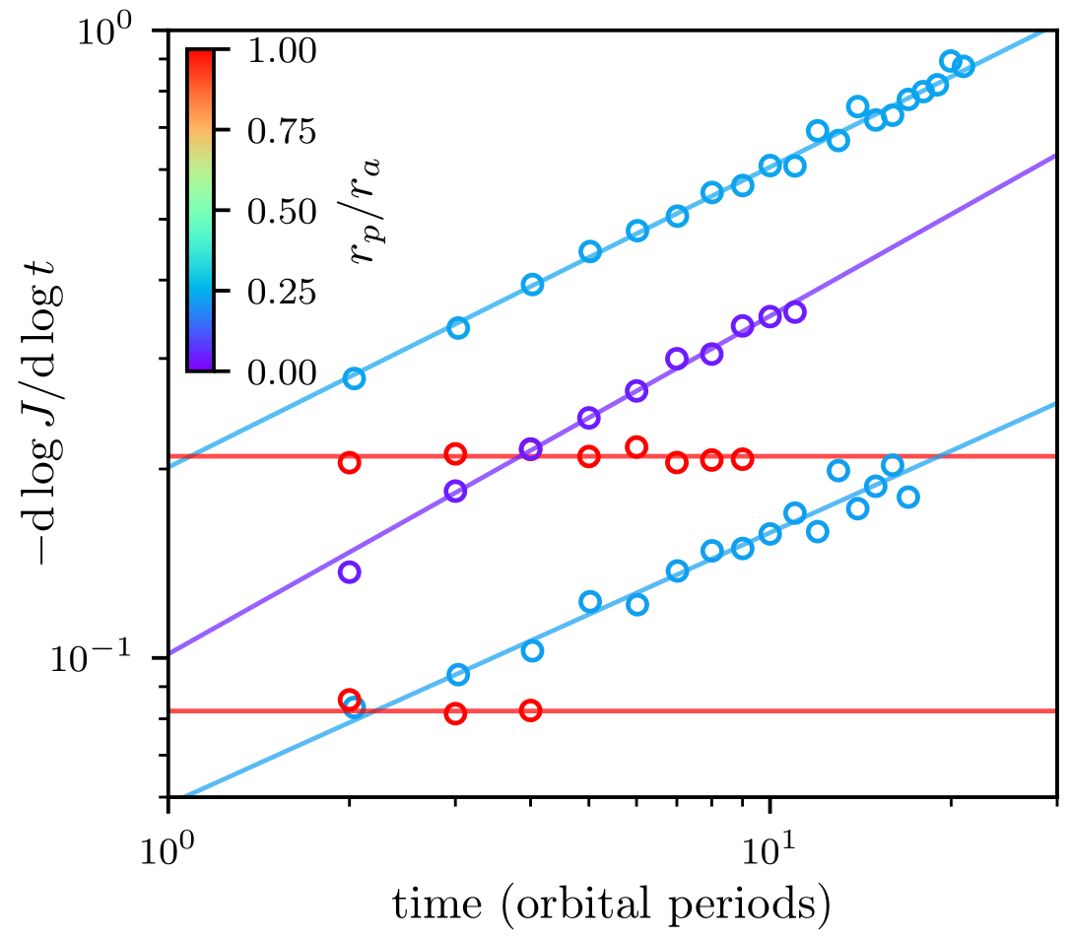
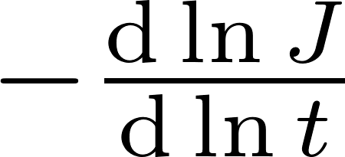
Microhalo annihilation rate
$$Γ∝$$
Want:
more radial
lower
orbit
Pericenter/apocenter
more circular
higher
orbit

Slide 8
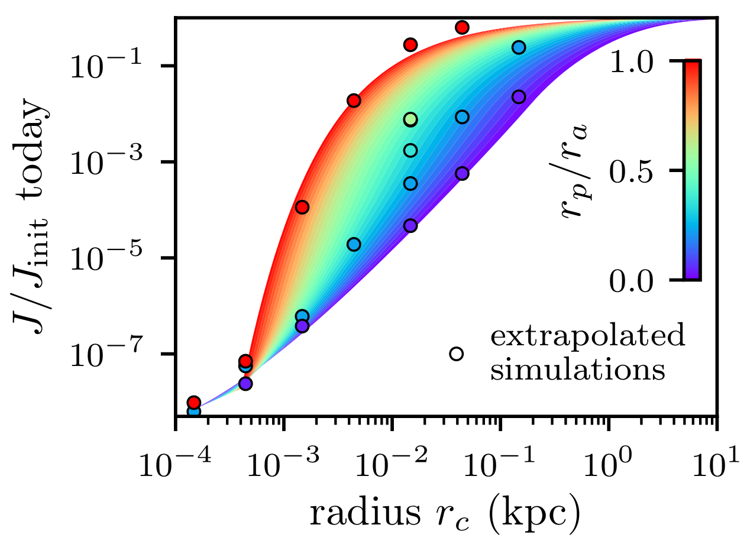
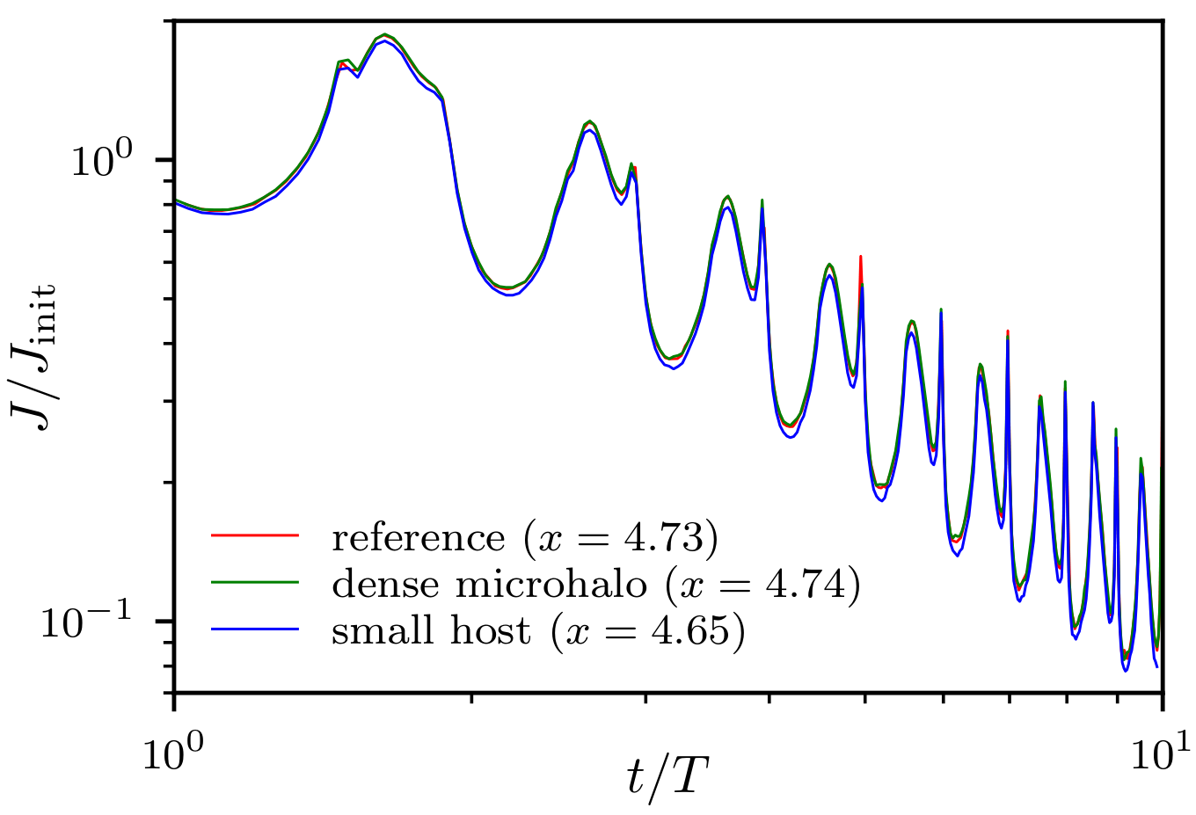
Modeling $J(orbit)$
Generalize to arbitrary
host-microhalo system:
radius $r→x∝\frac{\text{binding} \text{energy}}{\text{energy} \text{injected}\text{/}\text{orbit}}$
Model for Draco dSph and typical microhalo from one EMDE scenario:
System parameters are altered with $x$ held fixed.
Preliminary model
average radius (kpc)

Slide 9
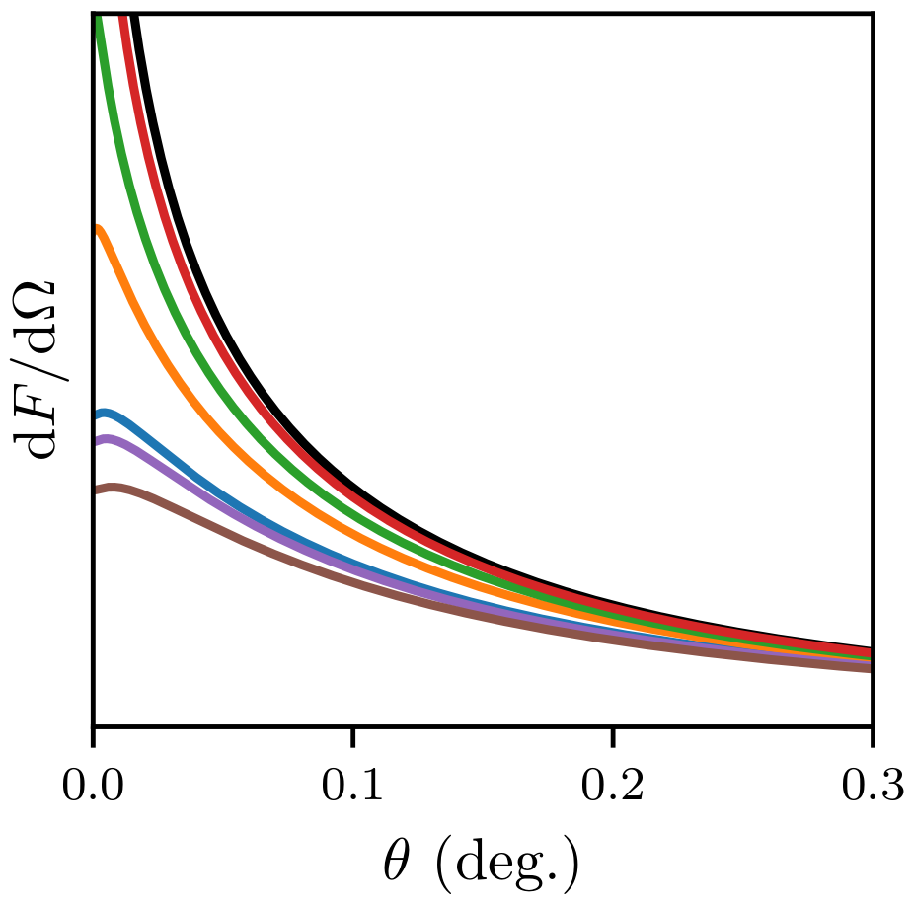
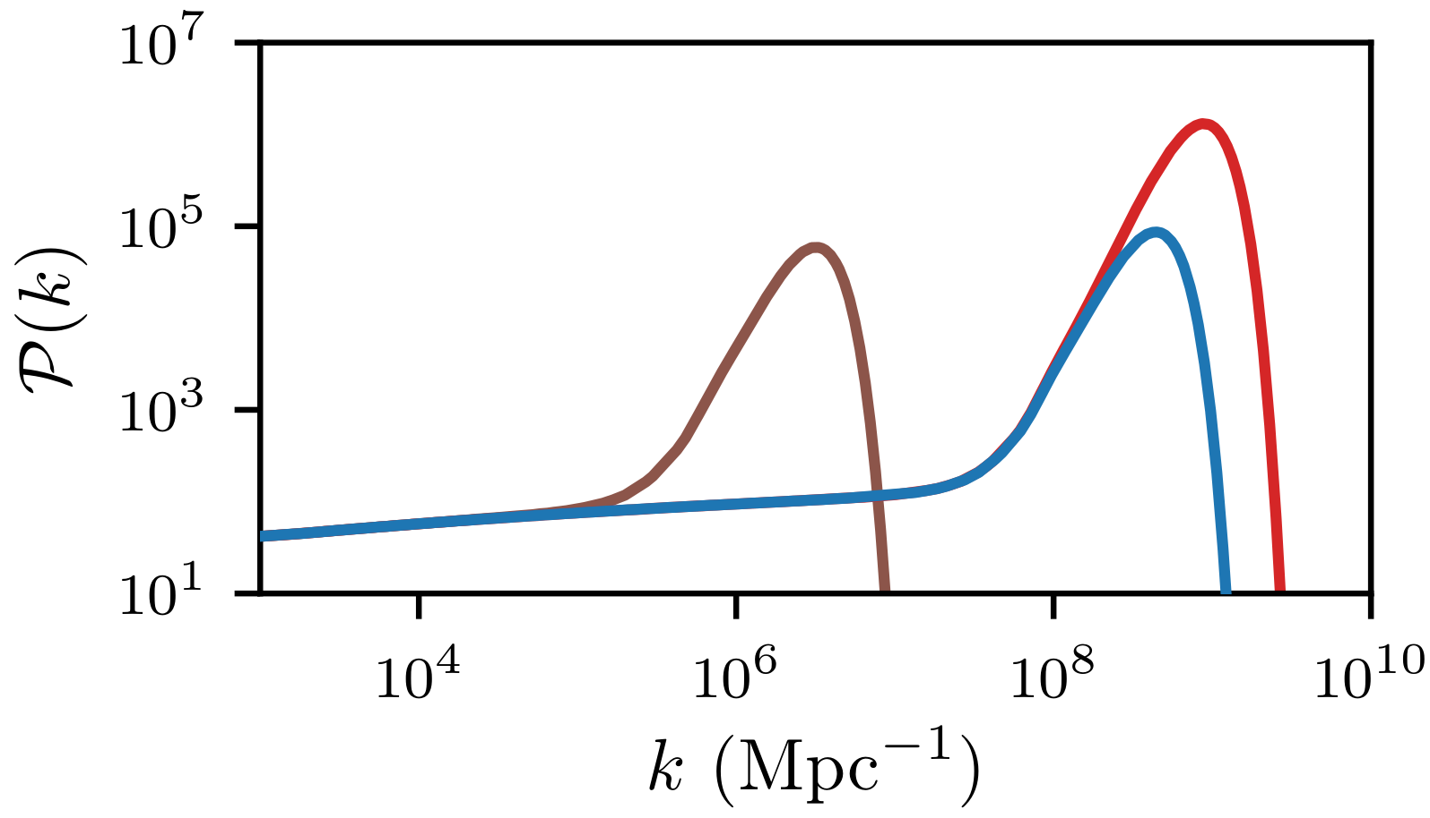
Emission profile
Find annihilation profile from Draco dwarf for various parameters $T_{RH}$, $k_{cut}/k_{RH}$
$$T_{RH}$$ | $$k_{cut}/k_{RH}$$
1 GeV | 40
1 GeV | 30
1 GeV | 25
1 GeV | 20
100 MeV | 20
10 MeV | 20
$T_{RH}=1$ GeV, $k_{cut}/k_{RH}=40$
$T_{RH}=1$ GeV, $k_{cut}/k_{RH}=20$
$T_{RH}=10$ MeV, $k_{cut}/k_{RH}=20$
Unsuppressed
$$k_{RH}$$
$$k_{cut}$$
from center
Delos, Bruff, Erickcek 2019
(forthcoming)
$J\left(\text{orbit}\right)$ model;
Orbital distribution
Microhalo population

Slide 10
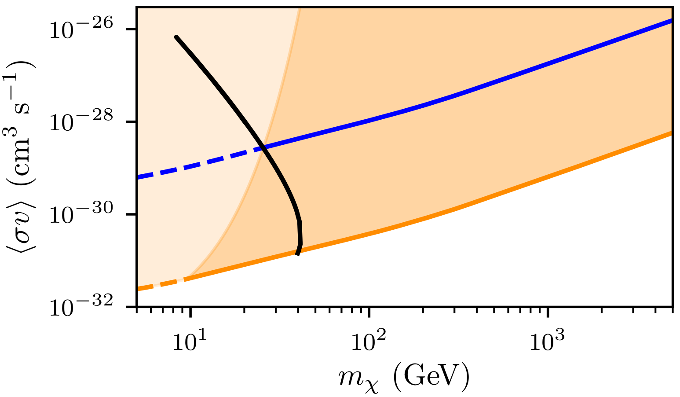
Constraining EMDEs
Using Fermi-LAT limits on gamma rays from Draco dwarf:
$$χχ→b\overline{b}$$
$$k_{cut}/k_{RH}=20$$
Thermal relic
May be ruled out
Ruled out
More to come!
$$k_{cut}/k_{RH}=40$$
$$T_{RH}=400 MeV$$
Late freeze-out could alter the power spectrum

Slide 11
Distinguishing between scenarios
Shape of emission profile
dSph vs GC vs isotropic background
Star
Decaying
DM
Dark matter
distribution
$$∝$$
EMDEs
tidally suppressed
Microhalo-stellar encounters
to predict Galactic center signal

Slide 12
Summary
EMDE enhances small-scale density fluctuations → most DM in microhalos
Tidal stripping model from N-body simulations
Tidal stripping determines emission profile from DM annihilation due to microhalos
Emission profile → constraints on thermal DM freezing out during EMDE

